Slide 1


MeetFit

Slide 2
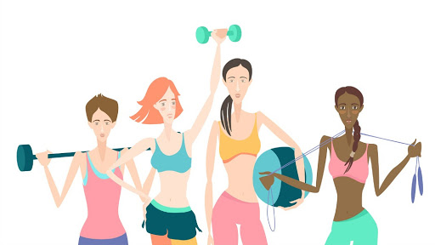
MeetFit
ABOUT MEETFIT
MeetFit is a web app designed for women who want to get fit. Through the web-app they can explore various fitness activities in their locality. Not only does this provide them with an opportunity to connect with other women having the same fitness interest but also form pairs or groups to participate in with them.

Slide 3



The Problem
Motivation
Unsafe Environment
Distance
It is always difficult to take the first step towards fitness on your own.
It becomes challenging to connect with other women due to distance.
Women experience sexual harassment at male-dominated fitness centres.

Slide 4

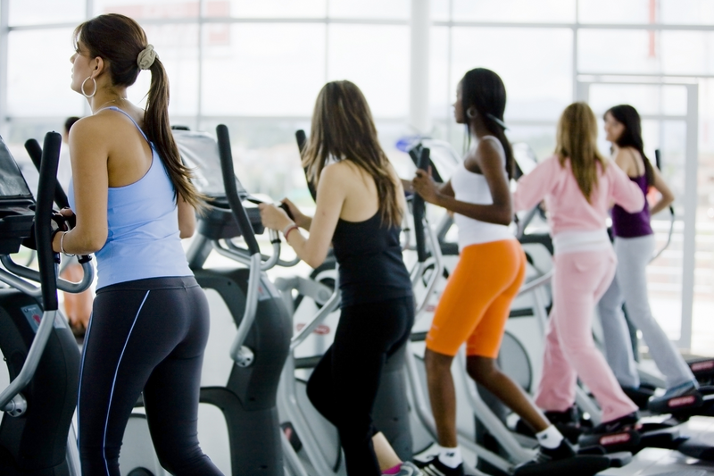
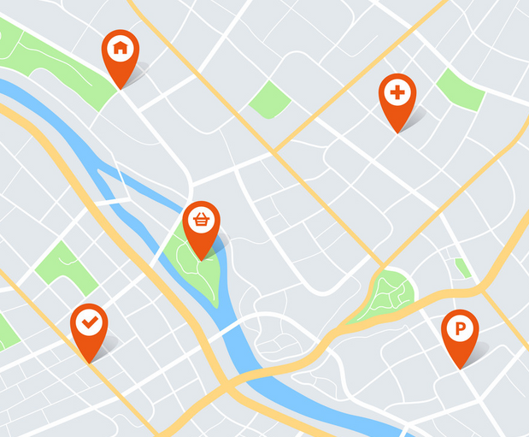
The Solution
Connectivity
Exclusive Fitness Centres
Nearby Profiles and Centres
Profiles of women with similar fitness interests
Information about fitness centres along with their all-women batch timings
Locality mention in profiles and centres enables better short-listing

Slide 5

The Product
Contact Fitness Centres
Discover fitness centres along with their timings for all-women batches and obtain their contact information for any queries.
Activities
Browse through various activities available nearby as well as the centres that offer these.
Discover and Connect
Find workout companions with similar fitness interests.

Slide 6
Extension
IDEAS WE PLAN TO IMPLEMENT IN THE FUTURE
01
Filter By Location
02
Prevent Creation of Fake Profiles
03
Personal Messaging
User will be able to view profiles and centres near to her current location, instead of just her residence.
Since the app is exclusively for women, signup will require linking of Aadhar Card so that misuse can be prevented.
The app will provide a platform for women to connect directly without providing their personal contact details.

Slide 7




Team TASK
Tirth Patel
Akriti Dalal
Sachi Kaushik
Khushang Thakkar

Slide 8
THANK YOU
From
Team TASK

